Slide 1


SECURITY PAPERS LIMITED
Corporate Briefing Session
June12th, 2026

Slide 2
Disclaimer
This presentation is not an offer or solicitation of an offer to buy or sell any security or investment.
This presentation has been prepared by Security Papers Limited (SPL) solely for information purposes.
No representation or warranty express or implied is made thereto, and no reliance should be placed on, the fairness, accuracy, sufficiency, completeness or correctness of the information or any opinion contained herein or any opinion rendered thereto except for the information derived from un-audited financial statements for the quarter ended March 31, 2026.
The information contained in this presentation should be considered in the context of the circumstances prevailing at the time and will not be updated to reflect any developments that may occur after the date of the presentation.
Neither SPL nor any of its officials, advisors, associates, employees or any person working for, under or on behalf, shall have any responsibility and/or liability of any nature whatsoever (in contract or otherwise) for any loss whatsoever arising from any use of this presentation or its contents or otherwise arising in connection with this presentation.
The presentation may contain statements that reflect SPL’s own beliefs and expectations about the future. These forward-looking statements are based on a number of assumptions about the future, which are beyond SPL’s control. Such forward-looking statements represent, in each case, only one of many possible scenarios and should not be viewed as the most likely or standard scenario. Such forward looking statements are subject to certain risks and uncertainties that could cause actual results to differ materially from those contemplated by the relevant forward-looking statements.
SPL does not undertake any obligation to update any forward-looking statements to reflect events that occur or circumstances that arise after the date of this presentation and it does not make any representation, warranty (whether express or implied) or prediction that the results anticipated by such forward-looking statements will be achieved. In addition, past performance should not be taken as an indication or guarantee of future results.

Slide 3


Contents & Format of Presentation
Profile of Company
Strategic/ Operational Developments
Details of Financial Information
Question & Answers

Slide 4

Profile of the Company

Slide 5
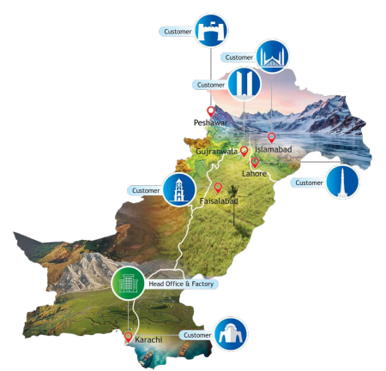
The Company’s Profile
Security Papers Limited is a strategic Company engaged in the business of manufacturing security paper for Banknotes and Other Security Paper products.
The Company head office and manufacturing facility is situated in Karachi, Pakistan.
The geographical presence of its customers are Karachi, Lahore, Gujranwala, Faisalabad, Islamabad and other major cities of the country.

Slide 6

Organizational Overview

Slide 7
Vision Statement
Mission Statement
Core values
Our Mission is to exceed the expectation of our Customers in producing, with security and efficiency, highest quality paper products, employing international best practices and applying an integrated approach to Product Research & Development, Manufacturing Technology, Operations Management, Counterfeit deterrence, Materials Procurement, Human Resource Management, Financial Ma
Striving for continuous improvement and innovation with commitment and responsibility.
Treating shareholders/stakeholders with respect, courtesy and competence.
Practicing highest personal and professional integrity.
Maintaining teamwork, trust and support, with open and
candid communication.
Ensuring cost consciousness in all decisions and operations.
Our Mission is to exceed the expectation of our Customers in producing, with security and efficiency, highest quality paper products, employing international best practices and applying an integrated approach to Product Research & Development, Manufacturing Technology, Operations Management, Counterfeit deterrence, Materials Procurement, Human Resource Management, Financial Management and information systems.
To be a nationally and internationally recognized and accepted Security Paper producing organization, providing highest quality paper to our customers, both in Pakistan and abroad.

Slide 8
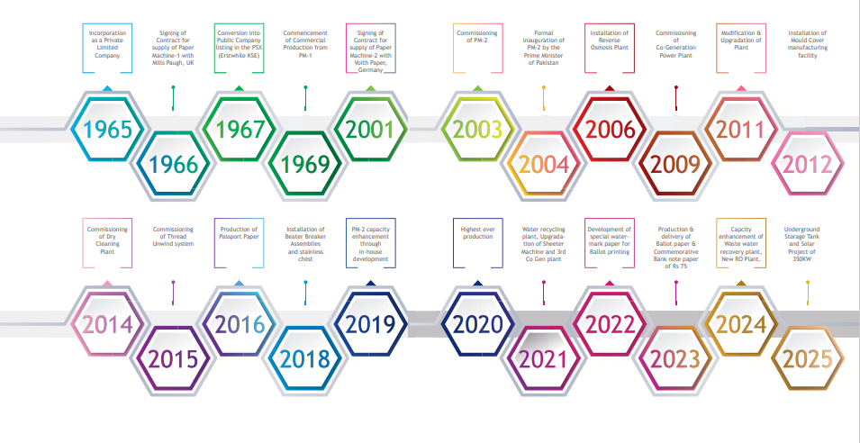
History of Major Events

Slide 9
Significant Events During the Year
347th Board of Directors' Meeting 30 July 2026 For Approving Annual Audited Financial Statements
348th Board of Directors' Meeting 11 September 2026 for other than financials
60th Annual General Meeting 26 September 2026 for Approving Annual Audited Financial Statements
351st Board of Directors' Meeting 25 March 2026 for other than financials
350th Board of Directors' Meeting 29 January 2026 For Approving Q-2 Un-Audited Financial Statements
349th Board of Directors' Meeting 29 October2026 For Approving Q-1 Un-Audited Financial Statements

Slide 10
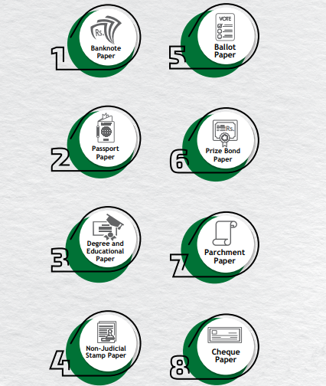
Product Portfolio
Major Customer
Pakistan Security Printing Corporation (Pvt) Limited
Election Commission of Pakistan
Universities & Education Boards – All over Pakistan

Slide 11
Corporate Awards History
22nd Annual Environment Excellence Award
Security Papers Limited (SPL) received the 22nd Annual Environment Excellence Award 2025 from the National Forum for Environment & Health (NFEH).
11th International Award on Environment Health & Safety
Security Papers Limited (SPL) has received the 11th International Award on Environment Health & Safety from The Professional Network.
HSE Recognition
SPL was recognized at the Health, Safety & Environment (HSE) Conference for its outstanding commitment to Health, Safety & Environment practices.
15th Annual Fire Safety Award 2025 – October 2025
Security Papers Limited (SPL) has received the 15th Annual Fire Safety Award 2025 from Publicity Channel.
Corporate & Sustainability Report Award
SPL was honored with the Best Corporate & Sustainability Report Award 2024, presented by the Joint Committee of the Institute of Chartered Accountants of Pakistan (ICAP) and the Institute of Cost and Management Accountants of Pakistan (ICMAP).
40th Corporate Excellence Award
SPL received the 40th Corporate Excellence Award from the Management Association of Pakistan (MAP).
11th Employers of the year Award 2025– January 2026
Security Papers Limited (SPL) has received the 11th Employers of the year Award 2025 from Employers Federation of Pakistan.
18th NFEH'S CSR Award 2026– April 2026
Security Papers Limited (SPL) has received the 18th NFEH'S CSR Award 2026 from Publicity Channel.

Slide 12


Governance

Slide 13
Board of Directors
NON-EXECUTIVE DIRECTORS
CHAIRMAN
Mr. Mohammad Aftab Manzoor
DIRECTORS
Mr. Jamal Nasim
Mr. Hamid Bazargan
Mrs. Pernur Alaybeyoğlu
Hafiz Mohammad Yousaf
Mr. Shafqaat Ahmed
Mr. Arshad Mehmood Bhatti
Mr. Munir Ahmed | Independent
EXECUTIVE DIRECTOR - CHIEF EXECUTIVE OFFICER
Mr. Imran Qureshi

Slide 14
Board Committees
Board of Directors
Board Audit Committee
Board Human Resource & Remuneration and Sustainability Committee
Board Investment and Risk Management Committee
Board Procurement &
Strategic Committee
Board Nomination and Special Committee
Notes:
Confirm about number of terms of Independent Director

Slide 15
Board’s Approved Policies
Corporate Social Responsibility Policy
Anti Harassment Policy
Investment Policy Guidelines
Risk Management Policy
Insider Trading Policy
Directors’ Remuneration Policy
Whistle Blowing Policy
Related Party Transactions Policy
Communication & Disclosure Policy
Environmental Policy
Occupational Health & Safety Policy
Quality Policy
IT Governance Policy
Policy for Record and Archive Management
Diversity, Equity, and Inclusion Policy
Succession Planning Policy
Welfare Fund (Employee WF) Policy
Performance Management Policy
Notes:
Confirm about number of terms of Independent Director

Slide 16


Strategic & Operational Development

Slide 17
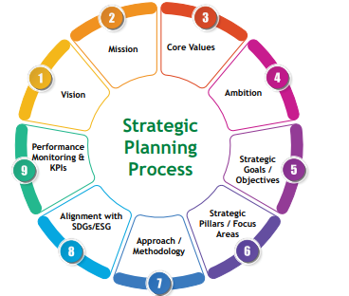
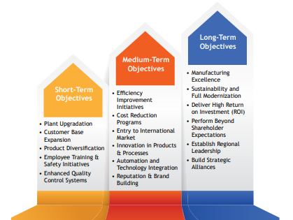
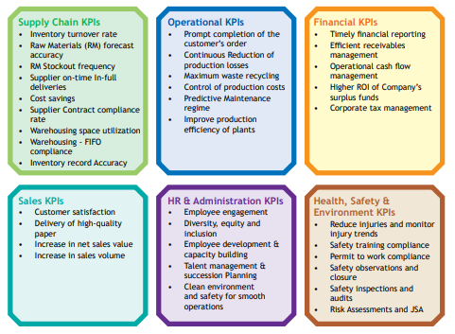
Strategic Planning Process

Slide 18
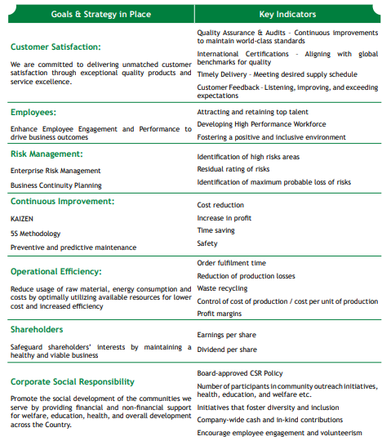
Strategic Goals

Slide 19
Future Outlook
Security Papers Limited is well-positioned to navigate the period ahead from a foundation of financial strength and operational stability. The ongoing plant upgradation project remains on track, and upon completion, will enable the Company to manufacture banknote papers with advanced security features in alignment with the new currency note series announced by the State Bank of Pakistan (SBP), reinforcing SPL's strategic relevance to its principal customer.
The Company remains mindful of geopolitical risks arising from the US-Iran conflict, which continue to pose challenges to global energy prices and international supply chains. Management is actively coordinating with key suppliers to ensure uninterrupted availability of critical raw materials and timely project execution.
Overall, the Company remains cautiously optimistic, supported by a disciplined approach to risk management and a clear strategic direction toward sustainable, long-term value creation.

Slide 20
Key Business Risks
SPL's Enterprise Risk Management (ERM) framework follows a continuous cycle of identifying, assessing, treating, and monitoring risks across the organization. Risks are evaluated on likelihood and impact, with treatment strategies such as avoidance, reduction, transfer, or acceptance, assigned with clear ownership of risk owners and escalation protocols.
Governance follows the Three Lines of Defence model, with departmental heads owning risks at the operational level, the Enterprise Risk Management Committee (ERMC) providing independent oversight, and Internal Audit delivering board-level assurance. The Board sets the overall risk appetite that guides all risk decisions.
Management continuously monitors risk exposure and applies mitigating controls to ensure residual risk stays within appetite, enabling proactive response to emerging threats and sustained stakeholder confidence.

Slide 21
Key Business Risks
Risk | Risk Cause & Effect
Extended plant shut down (15-30 days) | Cause: - Due to technical reasons Effect: - Stoppage of production - Unable to meet customer orders - Financial losses
Dependence on single customer / Shift to polymer- based banknotes / Demonetization of certain denomination of banknote paper | Causes: - Discontinuation of any denomination - Change in product specification. - Decision to replace paper-based currency with polymer-based currency. Effects: - Reduction in sales / Profitability
Fire Incident | Causes: - Raw materials used for manufacturing of product is fire hazard. - Welding work and use of Electrical appliances may cause fire incident. Effects: -Multiple injuries/fatality - Loss of material leading to business interruption impacting Company's reputation.
Risk | Risk Cause & Effect
Pilferage | Causes: -Sabotage / theft Effects: -Due to sensitivity of finished product and raw materials which affect national interest and organizational reputation holding security status A1.
Terrorist activity | Causes: -Due to prevailing law and order situations breach like forced entry/ suicide attack during shift in/ out at main gate area. Effect: -Loss of human life - Business interruption - Reputational loss
Disruption of IT Services due to major disaster or due to Cyber Attack / Ransomware / Virus / Malware / / Spam / Phishing Attack / Spyware / DDoS Attack / Technical Vulnerabilities | Cause: - Disaster i.e. Fire, Power outage, Earthquake, flood, Server Machines malfunctioning due to HVAC, Hardware / Software failure etc. Inadequate security & Access Management controls on Firewall, Network, Internet, Database / ERP, Email or Website etc. Effects: - Server machines, Hardware and communication network may get damaged resulting in not delivering IT services from short to long period. - Cyber attack may cause availability issue of Information Systems and may lead to irrecoverable loss of data and company reputation

Slide 22


Sustainability

Slide 23
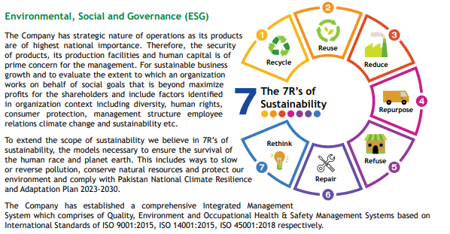
Sustainability

Slide 24
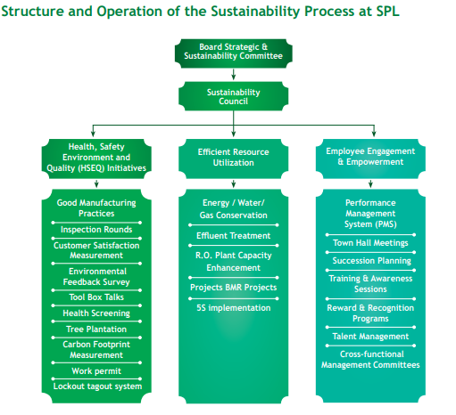
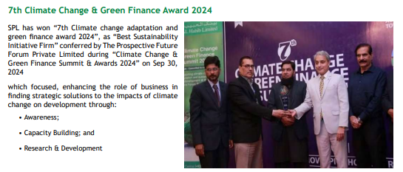
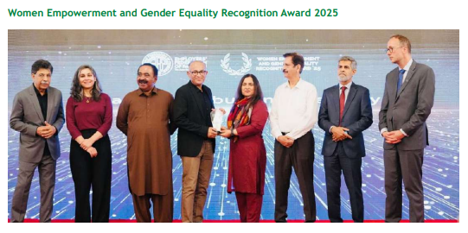
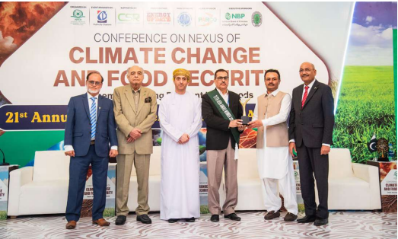
Sustainability and SPL

Slide 25
Value of investment in sustainability projects
Projects | 2025 - 26 (PKR in MN)
Projects Initiated during the Period
Upgradation of Mould Embossing Machine | 205 MN
Solar Power Projects 350 KW | 24 MN
Upgradation of Paper making Machine (PM-2) | Euro: 8.2 MN
Projects Completed During The Year
Development of RO Bores | 44 MN
Water storage tank | 65 MN
Automatic Fire Incinerator | 12.134 MN
Gas Engine Premium Long Block JGS 420 | 98 MN
Upgradation of CNC Milling machine | 3 MN

Slide 26


Financial Information

Slide 27
Financial Highlights
For the Period Ended March 2025-26

Slide 28
Profit or Loss
For the Period Ended March 2025-26

Slide 29
Statement of Financial Position
As at March 31, 2026

Slide 30
Year on Year comparison of key financial metrics for the last 4 years

Slide 31
Key Revenue Drivers
Majority sales of the Company are made to a single customer, i.e., Pakistan Security Printing Corporation Private Limited. Sales are made based on the indent received from the customer according to the requirement.
IFRS 8 (Operating Segment)
SPL's financial statements are prepared on the basis of a single reportable segment. All sales of the Company are made to customers located in Pakistan, and all non-current assets of the Company as at March 31, 2026 are located in Pakistan. Revenue from banknote paper represents 90% (March 2025: 95%) of the total revenue of the Company, which is earned from a sole customer, i.e., Pakistan Security Printing Corporation Private Limited.

Slide 32
Q & A

Slide 33
Thank You

